Slide 1
Database of Math
Zheng Yin

Slide 2
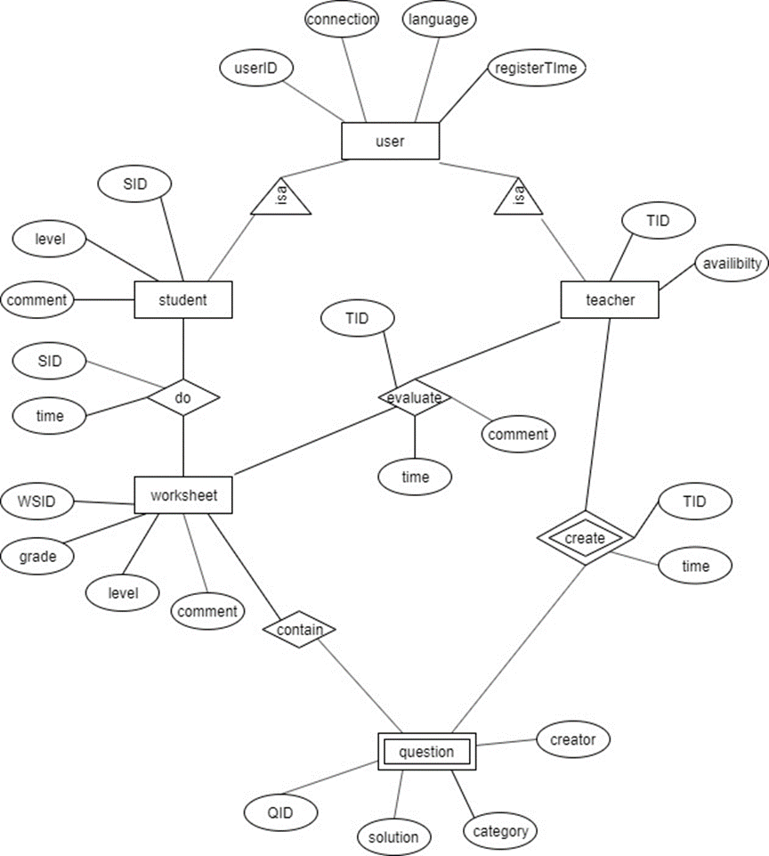
E-R diagram

Slide 3
Main objectives:
Developing a website to help any child that can go on internet with their math and produce a database to save children’s worksheet. The volunteer-teachers can view children’s work and grade children’s work, and teachers can answer users’ questions.
Users:
Children: children need to register on the website and choose the suitable math-level. They should download the worksheet from the current math level which they are in and do the questions. They can ask question about the worksheet or update their work by scan or take a picture of their finish worksheet.
Teacher: Volunteers need to evaluate children’s work from the website, and teachers give the feedback of the worksheet from student. Teachers can track all students about their math worksheet, and they can find the best students to get Math Olympiads. Teachers provide their connection information.

Slide 4
Output:
User (string userID; string connection; string language; string registerTime)
Student (string SID; int level; string comment)
Teacher (String TID; Boolean availability)
Worksheet (String WSID; int grade; int level; string comment)
Question (String QID; string solution; string category; string creator)
Description of Entity Sets:
User: the user of the website which contain all people who is using this website.
Teacher: information of the volunteer teacher.
Student: information of the children use this website to help with the math.
Worksheet: information about the question set like grade or comment.
Question: information about the math questions.

Slide 5
Conversion of Entity Set
User (UserID; connection; language; registerTime)
Student (SID; level; comment)
Teacher (TID; availability)
Worksheet (WSID; grade; level; comment)
Question (QID; solution; category; creater)
Conversion of Relationship:
Do (student; question; WSID; level; grade; time)
Evaluate (teacher, question; WSID; level; time; comment)
Contain (worksheet; QID)
Create (teacher; QID; solution; time)
Funcational Dependencies:
Student: SID ->level, comment, connection, language, registerTime.
Teacher: TID - > connection, language, registerTime, availibility
Question: worksheet, QID -> solution, category, creator

Slide 6
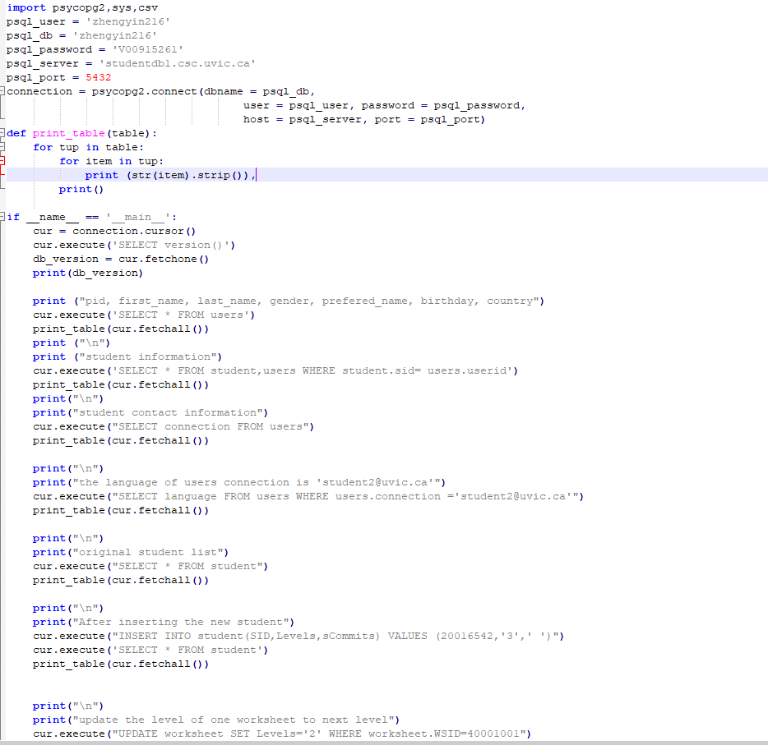
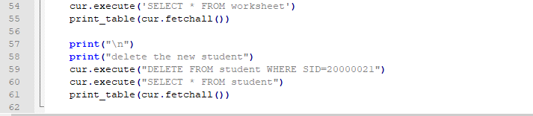
Python

Slide 7
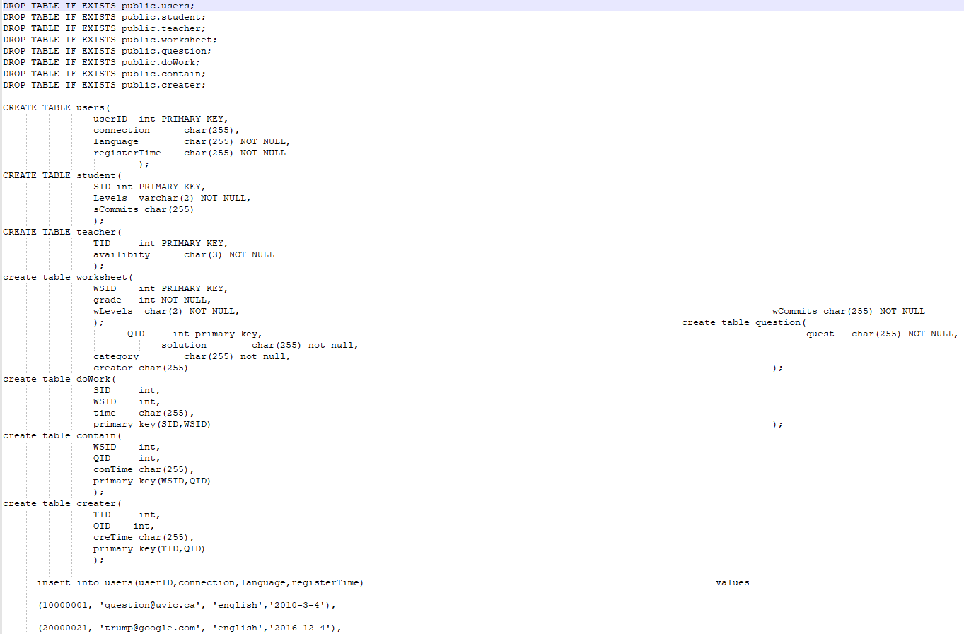
SQL code

Slide 8
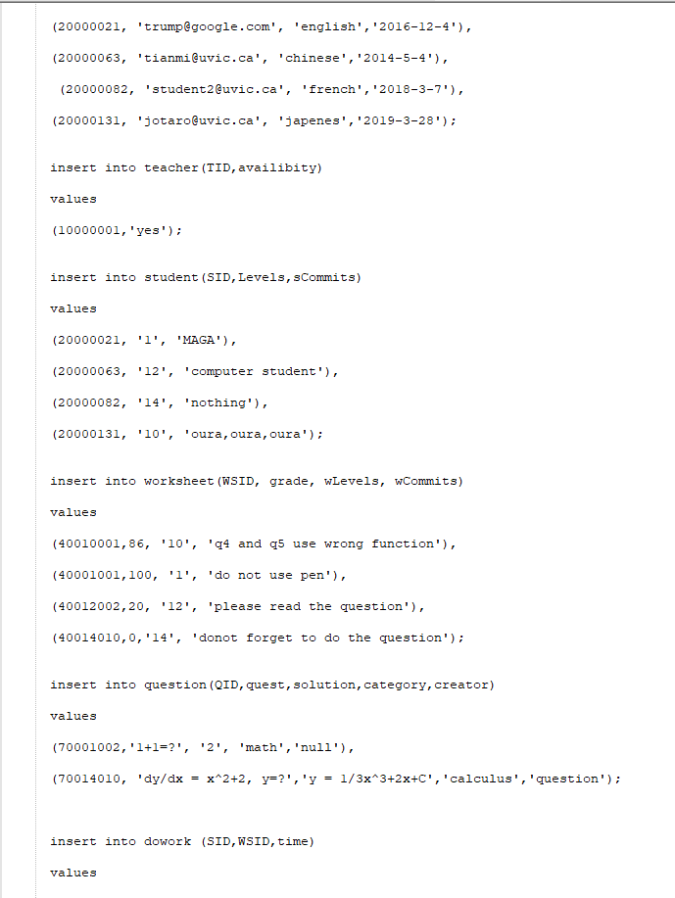
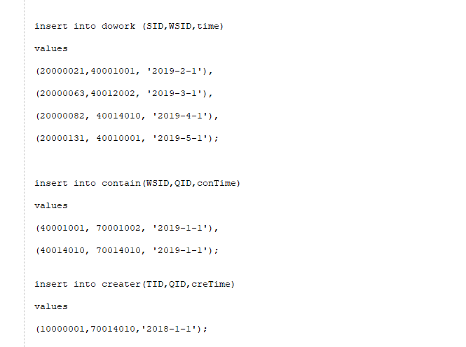

Slide 9
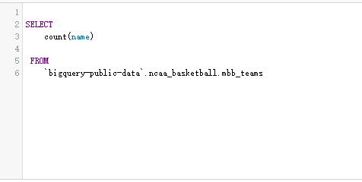

ncaa_basketball
How many teams in NCAA

Slide 10
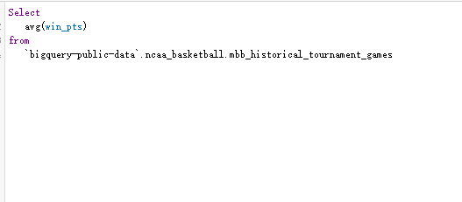

What is the average score of winners in every game from 1984?

Slide 11
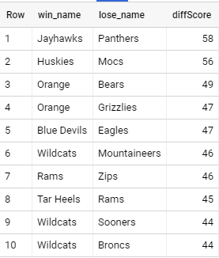
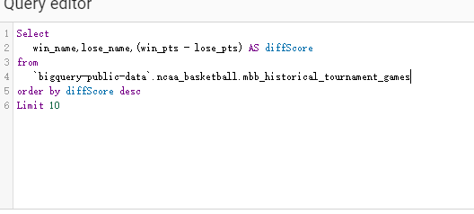
The top 10 game with highest score different.

Slide 12
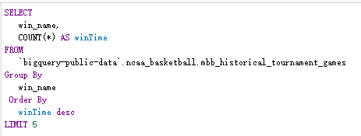
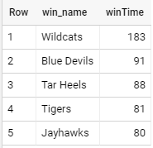
which teams are the top-5 win-teams in the history?

Slide 13
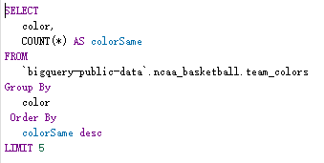
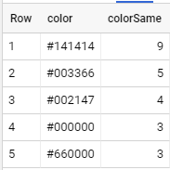



Which color is the most welcome for all the team?

Slide 14
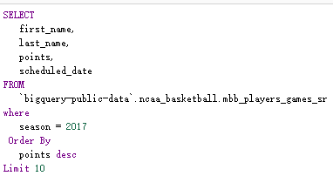
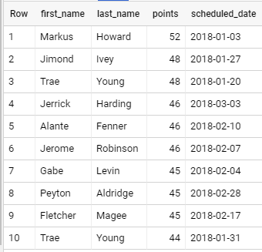
Top-10 got highest score in game after 2018?

Slide 15
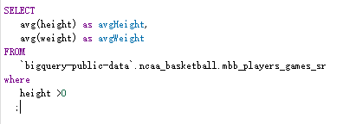

What is the average height and weight of players in ncaa?

Slide 16
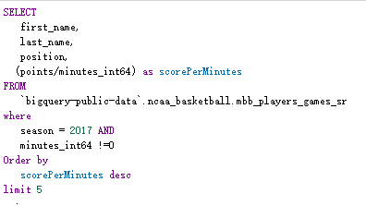
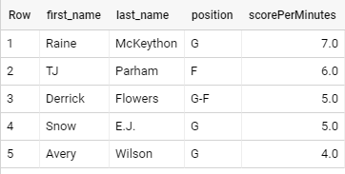
Top-5 get the higher score in a minute game in 2017?

Slide 17
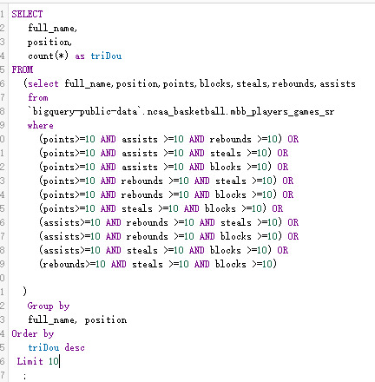
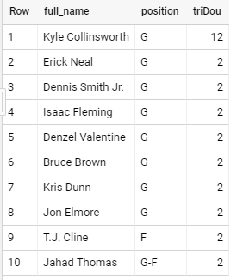
Top 10 got more times of triple-double?

Slide 18
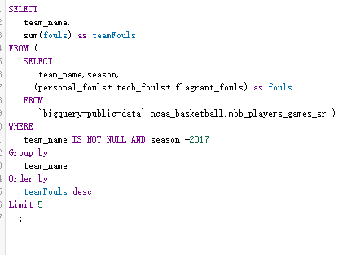
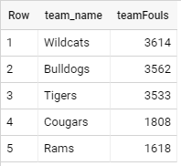
Top 5 team got more fouls in 2017?

